Slide 1
Prediction Challenge 5
Ali Awari

Slide 2
Visualizing Data
Around 55,000 different objects, 7 different variables.
P1, P2, Friends, Years Known, Type Of Interaction, Duration Of Interaction, Moon Phase.

Slide 3
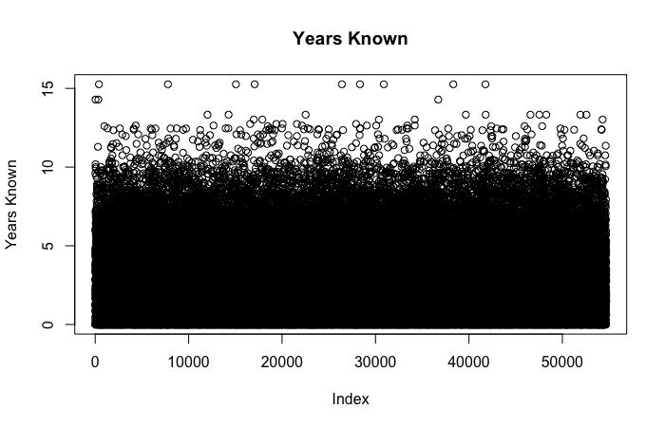
Years Known
It’s a complete mess, no pattern to see directly from the data and its frequency.

Slide 4
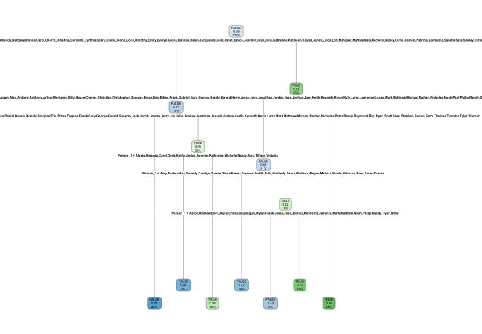
rpart
When we put all the data into rpart, all that comes out is relationships based on names. But it couldn’t be that the names themselves are the relationship?

Slide 5
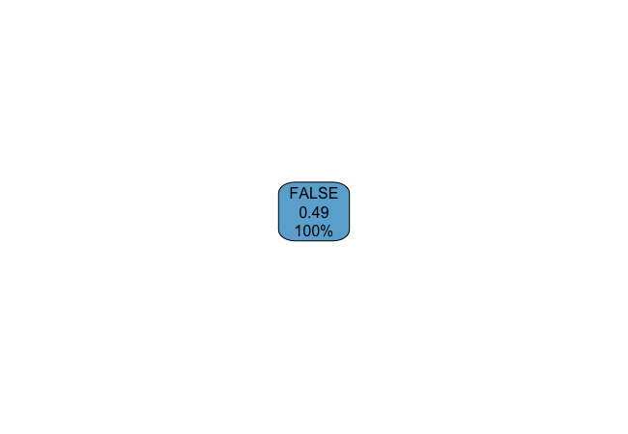
rpart cont.
Removing the names from rpart give us this. Hint that names are the relationships. To make sure look for a pattern anyway.

Slide 6
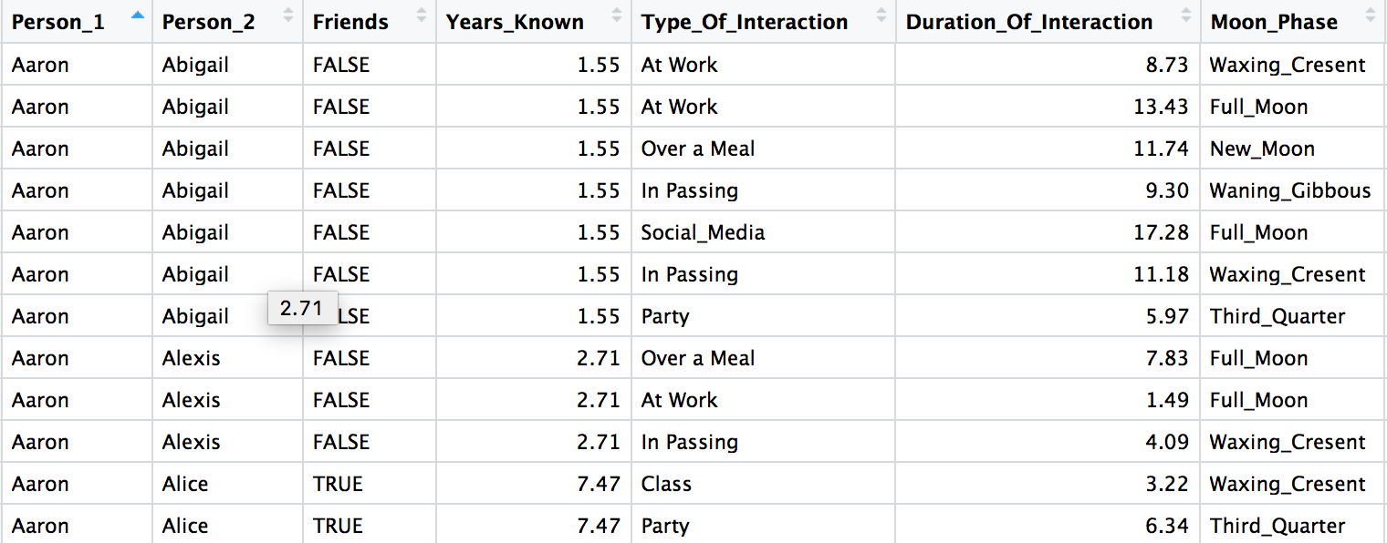
Finding the pattern
P1 + P2 is the relation between the Boolean Friends, seems to be the only constant from the data. I tried multiplying, adding, dividing number to find a hidden pattern but none emanate.

Slide 7
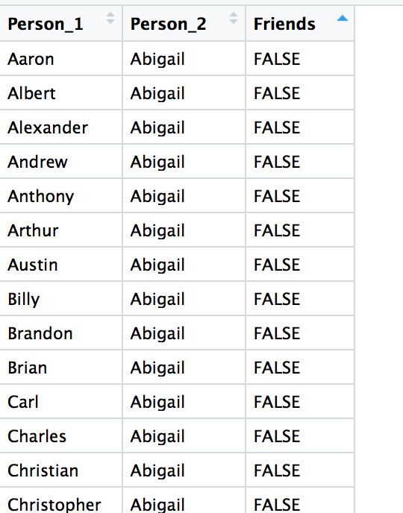
Creating a unique df
df <- unique(train)
10,000 different unique relationships.
100 unique relationships per. individual.

Slide 8
Coding the relationships
10,000 unique relationships, 54,702 instances of those relationships
Time to do a nested for-loop is absurdly long.
Hashmap? Subsets.
for(i in 1:nrow(test)){
temp <- subset(df, Person_1 == toString(test[i, "Person_1"]))
current <- subset(temp, Person_2 == toString(test[i, "Person_2"]))
test[i,]$Friends <- current[1,]$Friends
}

Slide 9
Take-aways
R, is highly optimized for data processing. Leverage their functions over your own.
It sometimes is the obvious answer.
Rpart cant do it all.

